Slide 1
Joining the Conversation

Slide 2

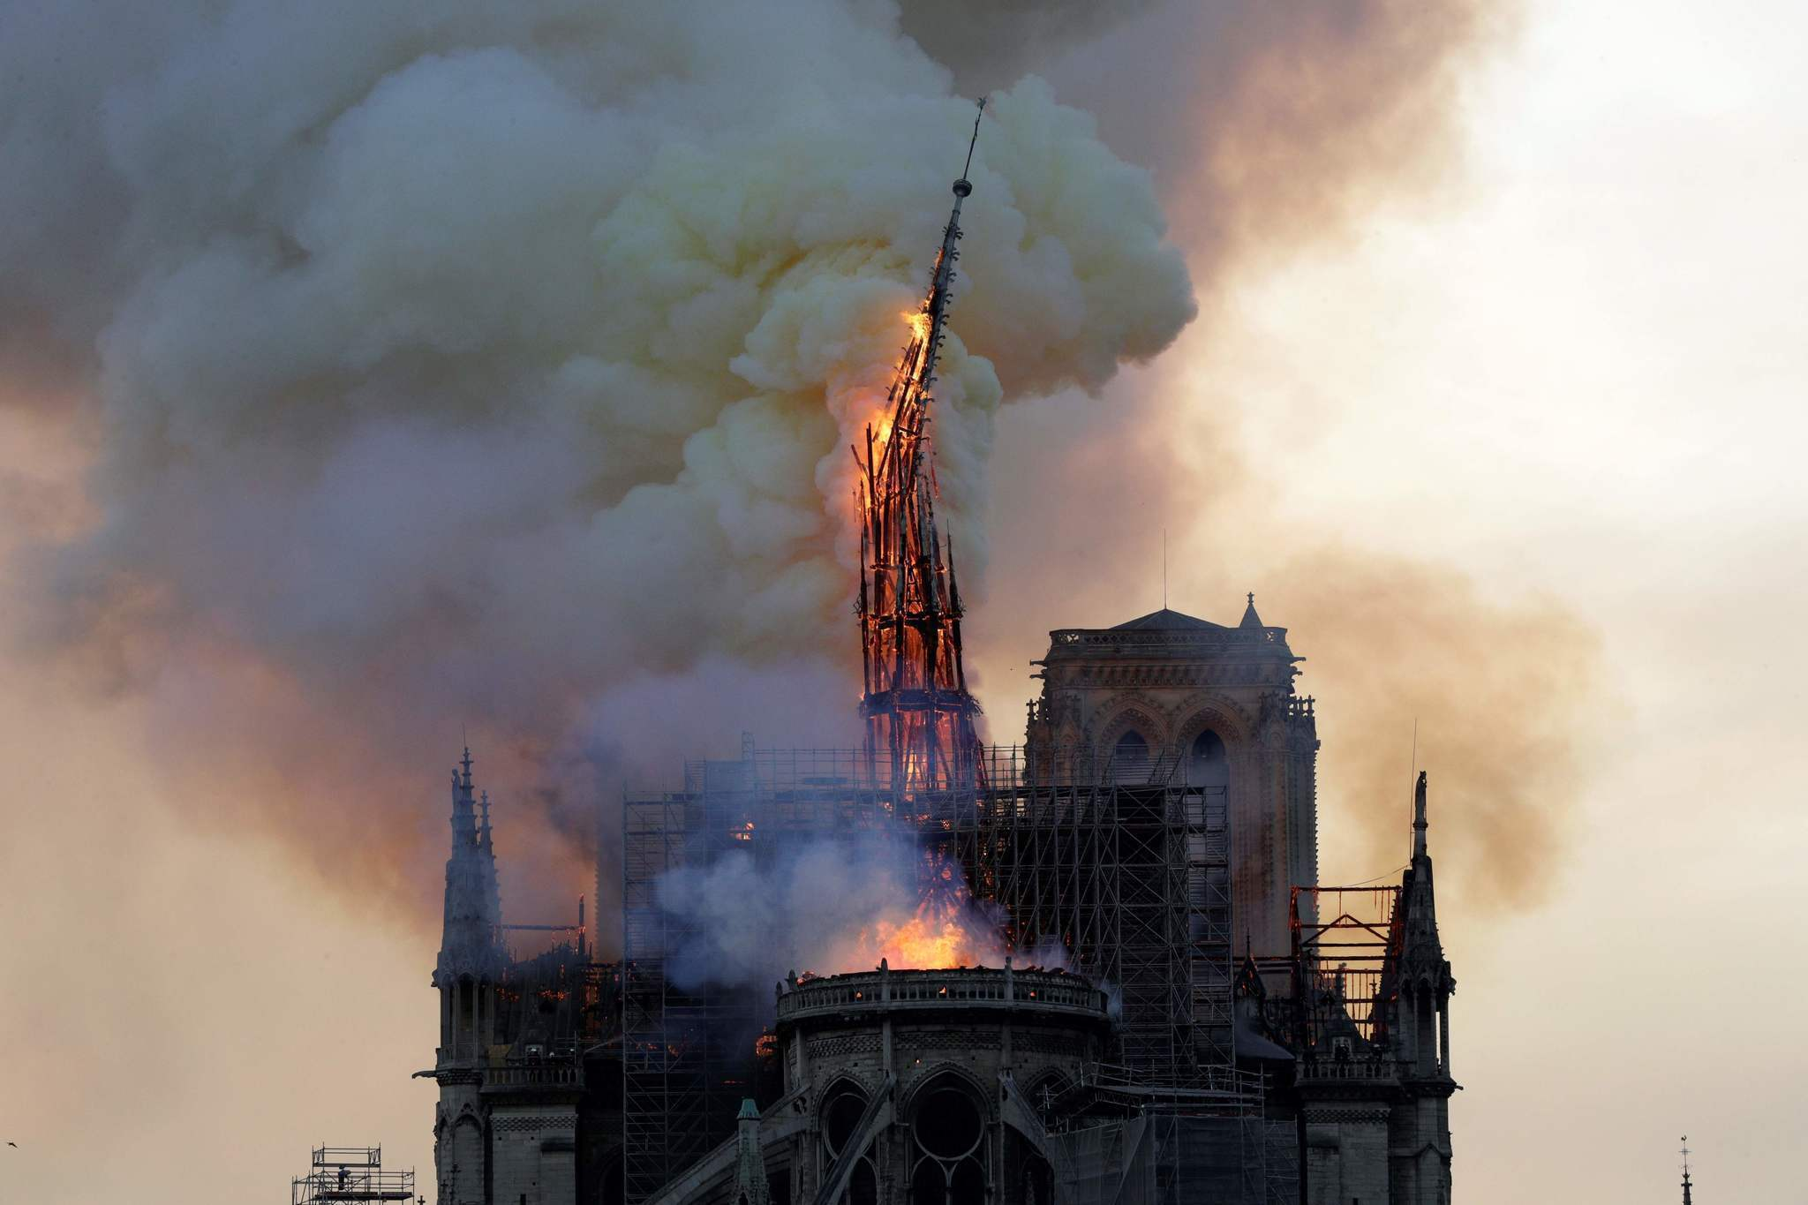
Notre-Dame de Paris

Slide 3
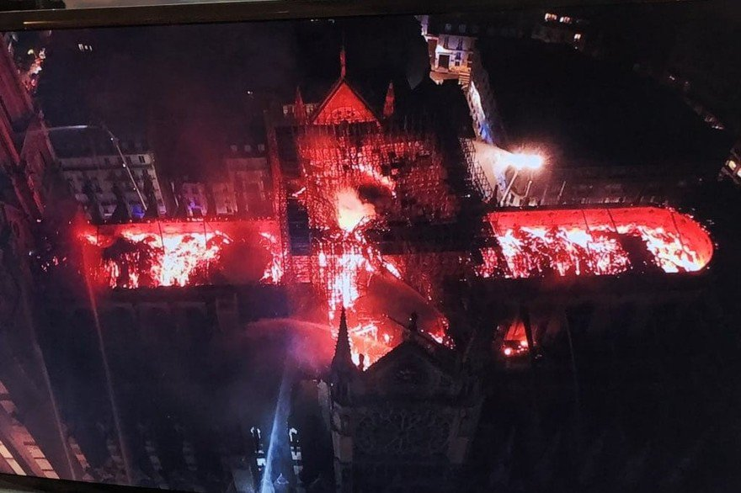
Notre-Dame de Paris

Slide 4

Notre-Dame de Paris
6/20/2003

Slide 5
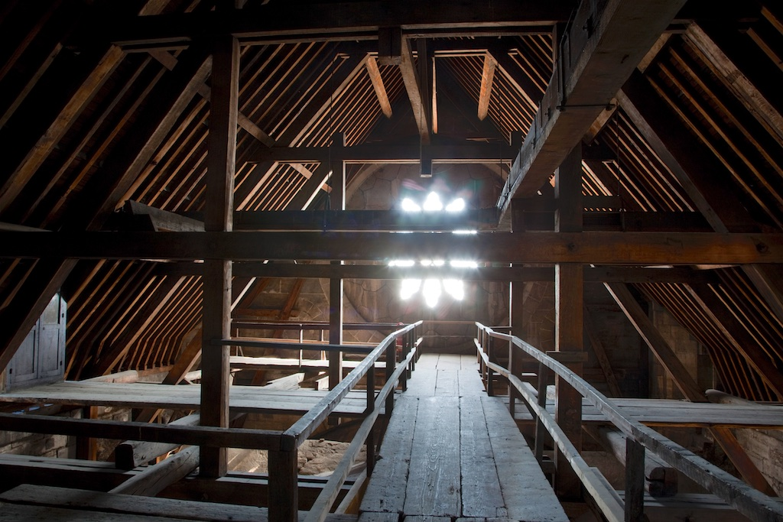
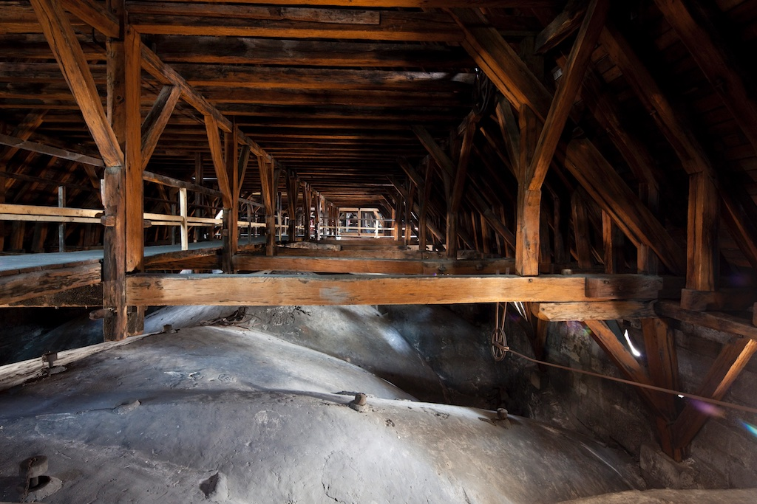
Notre-Dame de Paris
“le fôret” (“the forest”)

Slide 6
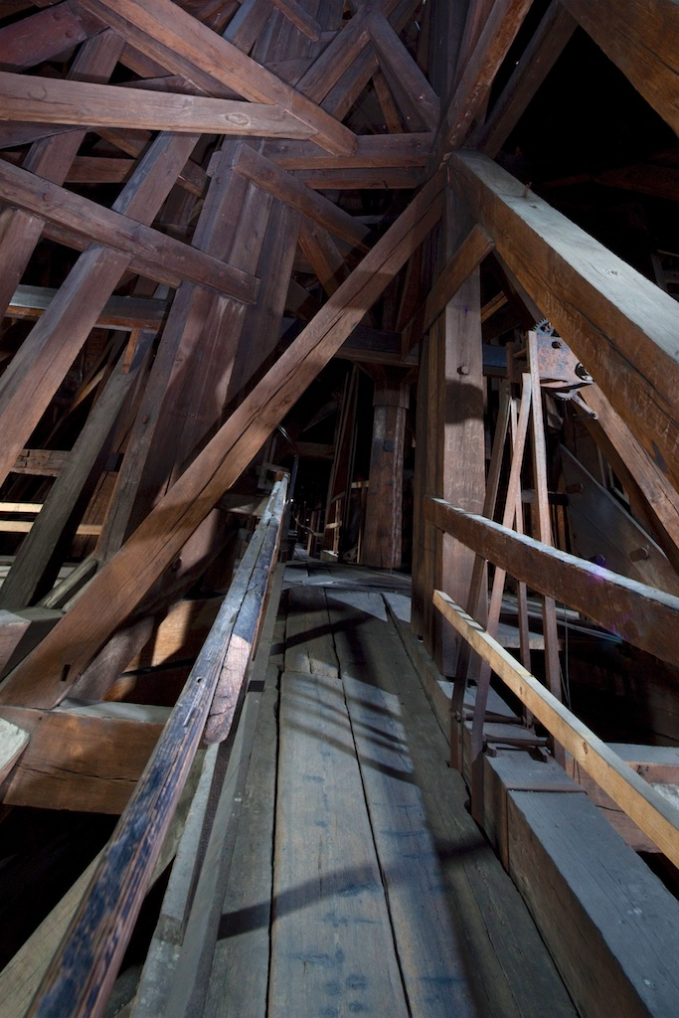
Notre-Dame de Paris
“le fôret” (“the forest”)

Slide 7
Fire at Canterbury cathedral (1174)
“But beams and braces burning, the flames arose to the slopes of the roof; and the sheets of lead yielded to the increasing heat and began to melt. Thus the raging wind, finding a freer entrance, increased the fury of the fire. […] And now that the fire had loosened the beams from the pegs that bound them together, the half-burnt timbers fell into the choir below upon the seats of the monks; the seats, consisting of a great mass of woodwork, caught fire, and thus the mischief grew worse and worse. And it was marvelous, though sad, to behold how that glorious choir itself fed and assisted the fire that was destroying it. For the flames multiplied by this mass of timber, and extending upwards a full fifteen cubits, scorched and burned the walls, and more especially injured the columns of the church. […] In this manner the house of God, hitherto delightful as a paradise of pleasures, was now made a despicable heap of ashes, reduced to a dreary wilderness.”
- Gervase of Canterbury, Chronica

Slide 8
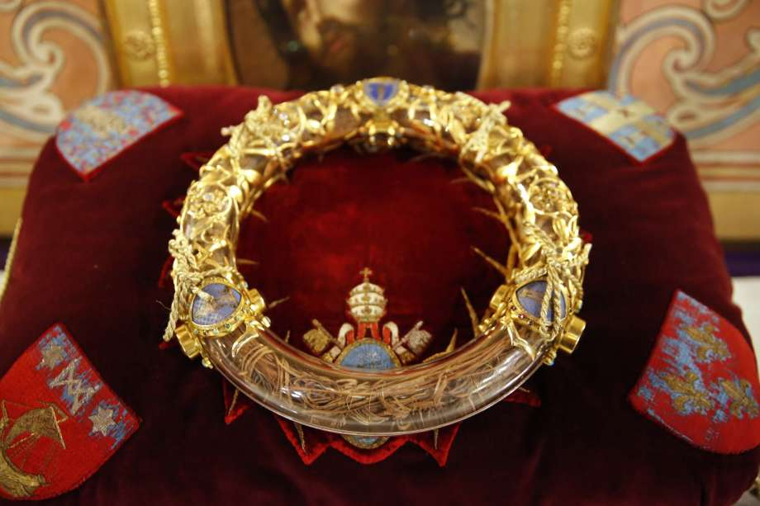
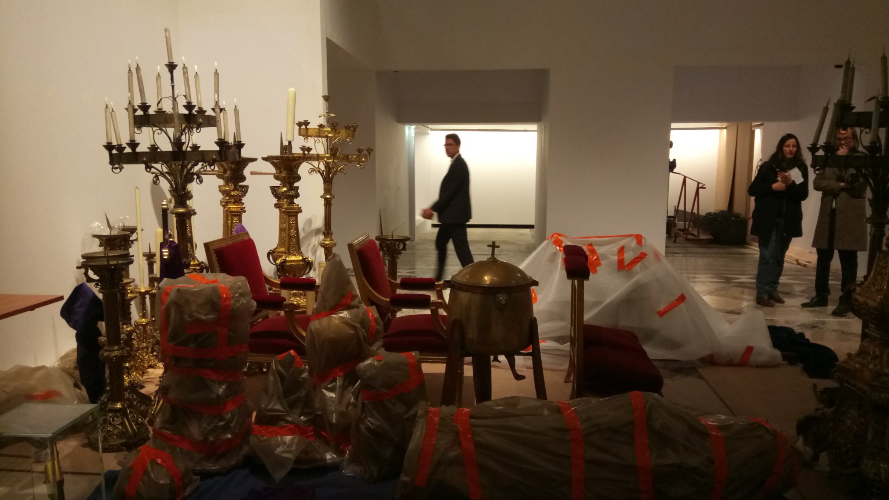
Notre-Dame de Paris
Crown of Thorns and other Treasures and Relics

Slide 9
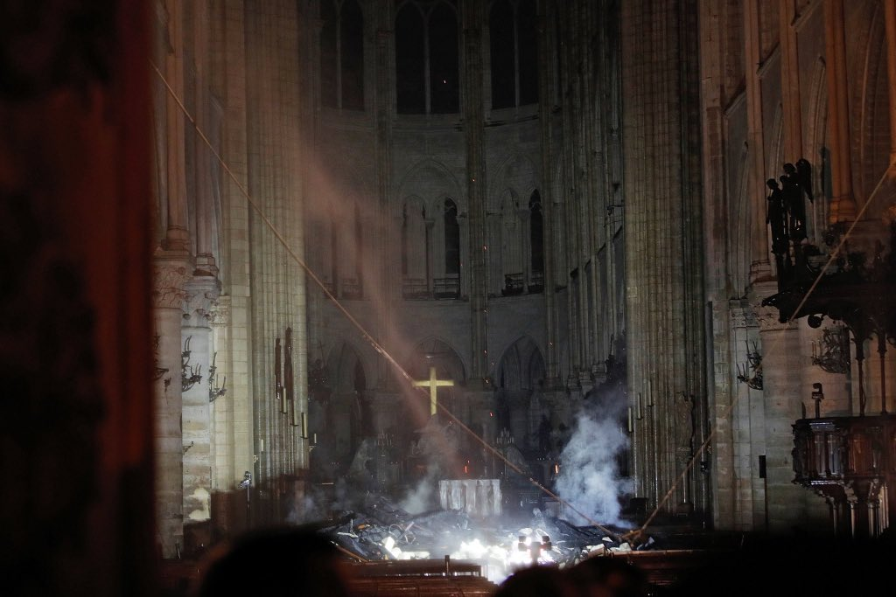
Notre-Dame de Paris

Slide 10

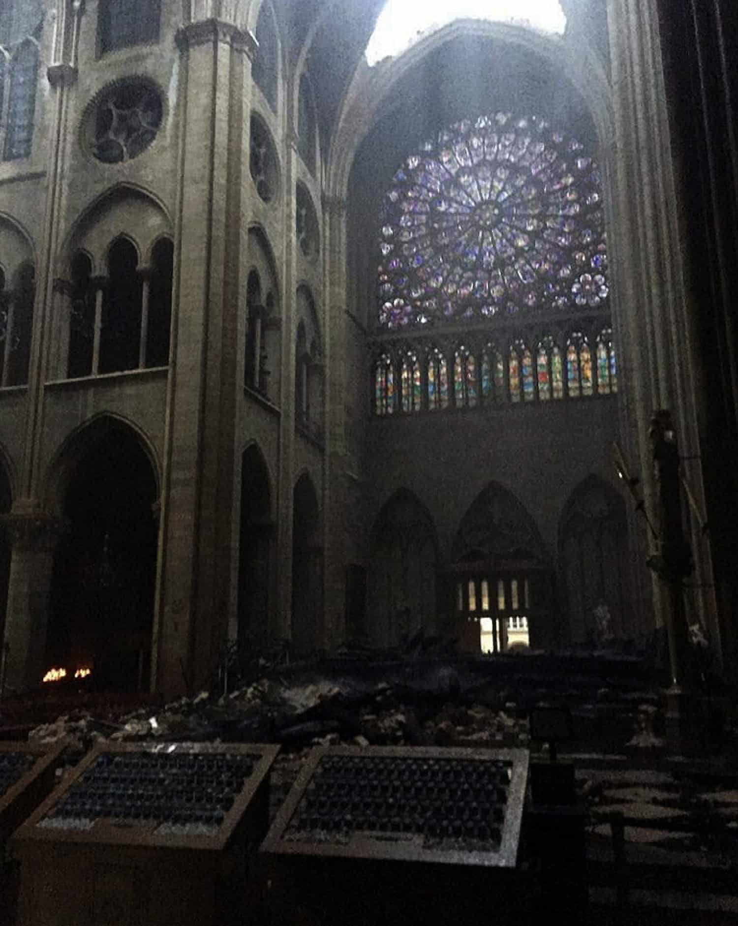

Slide 11

Notre-Dame de Paris

Slide 12
Joining the Conversation

Slide 13
How to use Sources
Sources can provide factual data or ideas
Factual data can be interpreted or used as evidence
(Often from primary sources)
Ideas can be built upon or dissented from
(Often from secondary sources)
Harvey 1.1

Slide 14
How to use Sources
Ideas often come in two varieties:
Claims made by another writer about the topic you are addressing, along with reasoning and support/evidence
Concepts – terms, theories, or approaches – that appear in discussions of various topics that you can apply to your own
Harvey 1.1

Slide 15
How to use Sources
To use another source, you must take a stance toward it
Yes (Yes, and so…)
No (No, rather…)
Sort of (Yes, but…; Yes, except…; Yes, if…”)
Harvey 1.1

Slide 16
Approaches to Secondary Sources
How do you insert yourself into the conversation?
Sources investigate the same problem, but come to different conclusions
“Sort of” to all – stake a claim in the middle
“No” to all – make a new interpretation
“Yes” to one, “Sort of” to another

Slide 17
Approaches to Secondary Sources
How do you insert yourself into the conversation?
Sources all agree with each other
“No” to all – make a new interpretation
“Sort of” to all – push their interpretation in a new direction

Slide 18
Approaches to Secondary Sources
How do you insert yourself into the conversation?
Sources have different problems, or different approaches to similar/same problems
“Sort of” to all – your interpretation brings approaches together, forces them to speak to one another

Slide 19
Approaches to Secondary Sources
Not every source needs to be addressed as part of your interpretation
Often, a source will make a minor claim about a specific topic that you find useful
Feel free to use that claim (“Yes, so…”) when relevant – you don’t have to make it part of your larger argument

